Slide 1

Employee Empathy Optimiser
Mid Term Presentation
Submitted By – Team 1
Shivam Chaudhary
Esha Palav
Sunny Saini
Jingjie Wang

Slide 2
Introduction
The whole project is to create a intelligent bot which can interact with Slack and predefined databases to provide output. The process of creating it is by using Web API methods available to bots.
The companies task management team have a vision to create an MVP for emotional tracking within the organization to understand if it is a good day or bad day in the company and report it to the top management in the organization.
After performing a successful manual research for two months in the organization they are now looking to create an automated working project which will be helpful within the organization and also serves as a product for external launch in the market.
Optum’s top management wants to know if it is a good day or bad day in the company for the very same reason. By knowing the emotional state of the employees, the colleagues and management can share empathy with the people who are having bad day.
This empathy will give a feeling of belongingness to the employee as they will realize that the company cares about them and understand what phase they are going through. This will ultimately boost the morale of the employees and increase the efficiency.

Slide 3
Introduction (Contd.)
The three main challenges with text mining for emotional tracking through Natural Language Processing are-
Statement Polarity (Positive, Negative, Neutral)
Statement Strength
And the biggest challenge, complexity of language
The methodology is divided into three parts with sub-sections as follows-
Data Extraction
Data processing (pre-processing, emotion annotation)
Experiments (Feature extraction, Classification)
We have used R to test, train and code our API. Tableau is used for daily visualization reporting to the top management.

Slide 4
Goals Reviewed
Employee Satisfaction
Flexible management
Motivated Team
Better Brain Storming Sessions
Weekly Kabala meetups ( Social get together where discussions points are not work related)

Slide 5
Proposal
The questions will be predefined and will have a flexibility for manager to update, delete or change the questions. We will also need to create a Feedback Bank for all kind of emotional rating from 1 to 5 to provide appropriate feedback based on participant’s emotion.
The visualization portal will have a Tableau Dashboard that can be embedded to the website portal of the company for individuals for all participants and manager. The manager will be able to see the visualization of all the employees and individuals can see their own past responses and visualization.
The whole model will look like this:
An API will show the set of questions to the participant
The responses will be saved in the database
An algorithm will take the average of the past responses to show the average emotional state of the participant.
A visualization will be completed in a real time and will be available at a different portal for manager and individual access.
An automated feedback will be provided to the participant.
The approach will include text mining and Likert scale model in R which will be connected to slack through slackr (package in R)

Slide 6
Proposal (Contd.)
The backend will work in a particular flow. The question responses are saved to database, there will be auto-average in database, find appropriate feedback based on average, create full time visualization at the end of the day, custom alerts and checking login credentials to database.
The analysis part includes constructing the dataset, cleaning the dataset, fitting model, and evaluate the model. Each process indicates a milestone to measure progress a0nd the finally evaluation process will be considered as the measure of success. The programming part include building interactive conversation with end-users, recording and re-arranging inputs from end-users, filter and transfer inputs to relevant values, store above values into dataset, and finally give prediction feedback to end-users of telling them whether they have a good or bad day.
The key risks in this project will be the low accuracy of the prediction model. Our dataset only includes 700 rows of unique entities, which is too less to build a reliable model. The bigger size of dataset we have, the much accurate model the machine can create. Each row of entities offers an experiment opportunity for the machine to learn the model. Low volume of dataset will cause a risk of having uncertainty in the project.

Slide 7
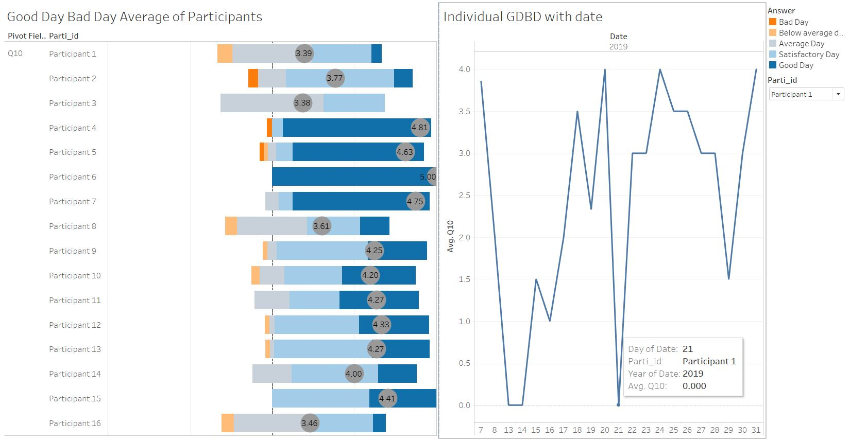
Visualization Dashboard
We created a dashboard with two graphs that shows the good day, bad day of all the individuals
with the moving average and filter to see every individual’s performance on a particular date

Slide 8
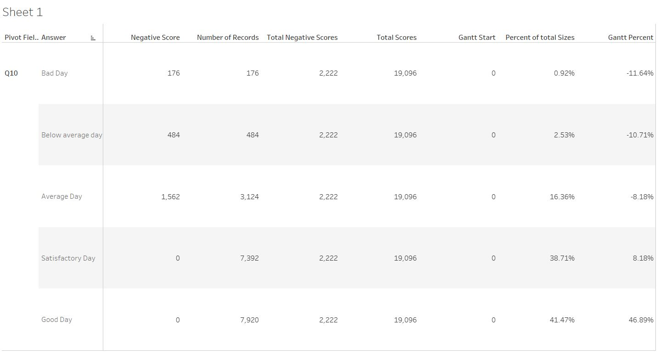
Visualization Dashboard
The first graph is a Gantt chart created using the calculations in Tableau. It middle dotted line
shows that everything on left of it is below satisfactory and everything on the right is above
Satisfactory
The table used for the calculations is given below-

Slide 9
Visualization Dashboard (Calculations)
Negative Score :-
IF [Pivot Field Values] < 3 THEN 1
ELSEIF [Pivot Field Values] = 3 THEN 0.5
ELSE 0
END
Percent of total sizes:-
SUM([Number of Records])/[Total Scores]
Total Negative Scores:-
TOTAL(SUM([Negative Score]))
Total Scores:-
TOTAL(SUM([Number of Records]))
Gantt Start :-
-[Total Negative Scores]/[Total Scores]
Gantt Percent :-
PREVIOUS_VALUE([Gantt Start]) + ZN(LOOKUP([Percent of total Sizes],-1))

Slide 10
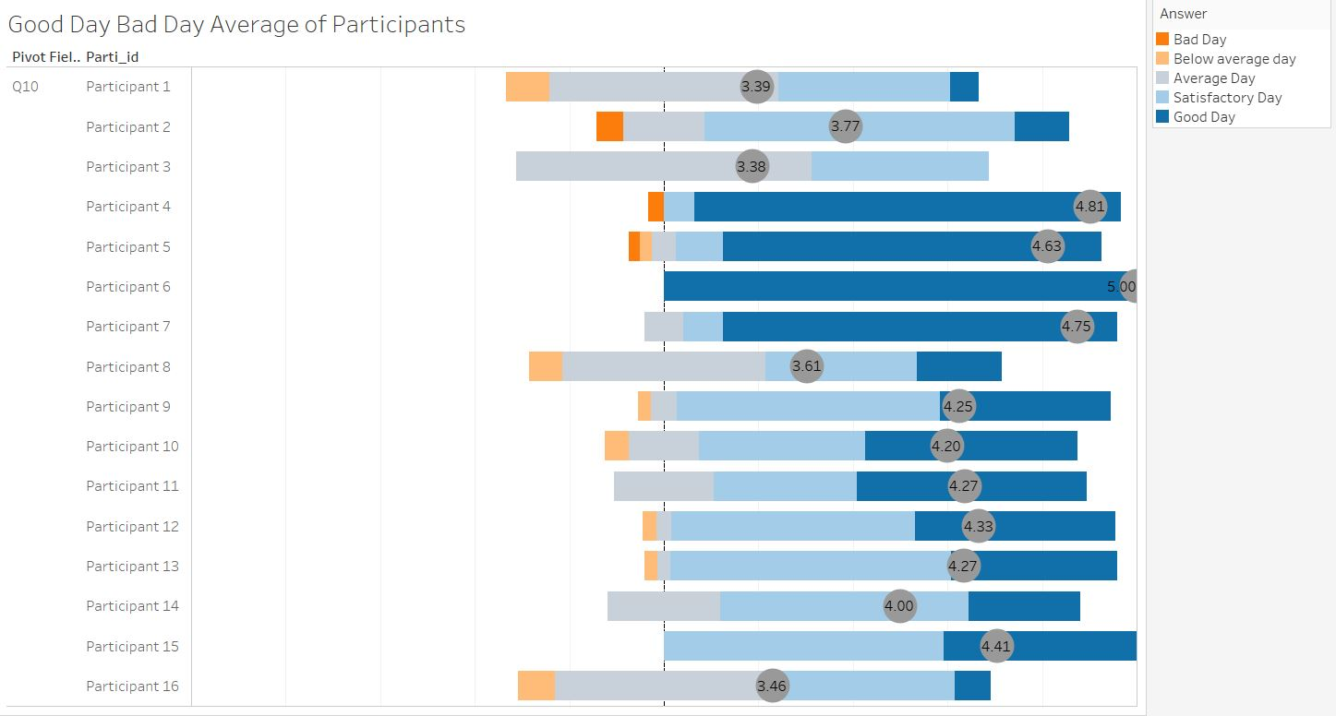
Visualization Dashboard

Slide 11
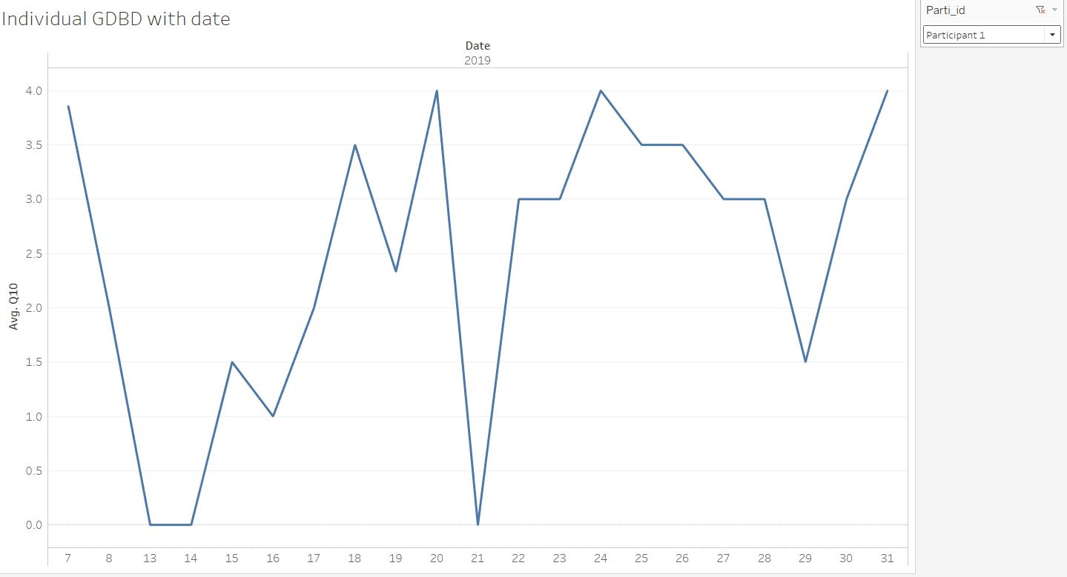
Visualization Dashboard
Second graph is just a line graph which shows the individual’s performance according to the
date. We have added a filter to change and see the individual performance of different
participants

Slide 12
Connectivity
After downloading the Employee login page which was a Bootstrap plugin we faced an issue connecting that page to a Tableau dashboard. Therefore after digging deeper we found out that this could be implemented in Tableau itself:
In the Tableau Desktop, open the workbook you want to publish.
Select Server > Publish Workbook.
If the Publish Workbook option does not appear on the Server menu, make sure a worksheet or dashboard tab is active (not the Data Source tab).
In the Publish Workbook dialog box, select the project, enter a name for the workbook, and add search tags.
For Permissions, accept the default project settings.
Generally, a site administrator manages permissions on the server.

Slide 13
Connectivity
For Data Sources, select Edit if you want to change whether the data is embedded in the workbook or published separately, or change how people authenticate with data sources.
If you’re publishing an extract and want to set up a refresh schedule, you must select Embed password or Allow refresh access.
If your workbook connects to a Tableau data source, we recommend embedding the password. If you instead choose to prompt users, they'll need additional permissions on the data source.
Configure Variable publishing options that are available for this workbook.
Click Publish.
(Optional) Set up a refresh schedule for each extract you published.

Slide 14
Connectivity
After performing these steps now we need to Set Credentials for Accessing the Published Data:
The type of authentication to your data source is independent of how people sign in to your Tableau Online or Tableau Server site. For example, to give people direct access to the data in a workbook, you would embed a database user’s credentials into the data source’s connection. But anyone viewing the workbook would still need to be able to sign in to the site on Tableau Online or Tableau Server to open your workbook.
The following are the steps that describe how to set authentication on data connections as part of the publishing process.
For many types of connection you can embed a database user’s name and password, or use single sign on (SSO).
The following steps describe how to set authentication as part of publishing a data source or workbook. You can do this for each connection in the data source.
In the Publish Workbook dialog box, go to the Data Sources area, which lists the workbook’s connections, and select Edit.
In the Manage Data Sources popup, after you decide whether to publish the data source separately or as part of the workbook, select an authentication type for each connection in the data source.

Slide 15
Connectivity
The available authentication types depend on the connection type, and they can include one or more of the following:
Prompt user: Users must enter their own database credentials to access the published data when the view or workbook loads.
Embedded password: The credentials you used to connect to the data will be saved with the connection and used by everyone who accesses the data source or workbook you publish.
Server run as account: A single Kerberos service account will be used to authenticate the user. On Windows this is the account that Tableau Server runs as. On Linux it can be any Kerberos account.
Viewer credentials: The viewer’s credentials are passed through to the database using SSO (usually Kerberos).
Impersonate with embedded account or Impersonate with server Run As service account: Impersonation using embedded credentials connects with the embedded credentials and then switches to the viewer’s identity (only for databases that support this). Impersonation using the Run As service account is similar but first, connects with the Kerberos service account before switching to the viewer’s identity.

Slide 16
Connectivity
Refresh not enabled or Allow refresh access: These options appear when you publish an extract of cloud data such as from Salesforce, and database credentials are needed to access the underlying data. Allow refresh access embeds the credentials in the connection, so that you can set up refreshes of that extract on a regular schedule. Setting Refresh not enabled prompts users when they open the workbook.
Important: How you want to keep extracted data fresh is also a factor:
If you want to set up an automatic refresh schedule, you must embed the password in the connection.
If you’re publishing a cloud data connection to Tableau Online, the publishing steps will alert you if you need to add Tableau Online to the data provider’s authorized list.
You can’t publish an extract that’s created from a Kerberos-delegated, row-level-secure data source.

Slide 17
Connectivity-For Dropbox and OneDrive connections
For Dropbox and OneDrive, when you publish a data source or workbook and select Embedded password, Tableau creates a saved credential and embeds it in the data source or workbook.
When you publish a workbook that connects to a Tableau Online or Tableau Server data source, rather than setting the credentials to access the underlying data, you set whether the workbook can access the published data source it connects to. Regardless of the original data type, the choice for server data sources is always Embedded password or Prompt users.
If you select to prompt users, a user who opens the workbook must have View and Connect permissions on the data source to see the data. If you select embed password, users can see the information in the workbook even if they don’t have View or Connect permissions.

Slide 18
Code (Dataset Inspection)
df <- df %>% mutate(
GDBD = case_when(
df$Q10 >= 3 ~ 'GoodDay',
df$Q10 <= 2 ~ 'BadDay',
TRUE ~ 'Unknown'
)
)
# df$Q1 <- ifelse(df$Q1 == 0, NA, df$Q1)
# df$Q2 <- ifelse(df$Q2 == 0, NA, df$Q2)
# df$Q3 <- ifelse(df$Q3 == 0, NA, df$Q3)
# df$Q4 <- ifelse(df$Q4 == 0, NA, df$Q4)
# df$Q5 <- ifelse(df$Q5 == 0, NA, df$Q5)
# df$Q6 <- ifelse(df$Q6 == 0, NA, df$Q6)
# df$Q7 <- ifelse(df$Q7 == 0, NA, df$Q7)
# df$Q8 <- ifelse(df$Q8 == 0, NA, df$Q8)
# df$Q9 <- ifelse(df$Q9 == 0, NA, df$Q9)
df$Q1 <- as.factor(df$Q1)
df$Q2 <- as.factor(df$Q2)
df$Q3 <- as.factor(df$Q3)
df$Q4 <- as.factor(df$Q4)
df$Q5 <- as.factor(df$Q5)
df$Q6 <- as.factor(df$Q6)
df$Q7 <- as.factor(df$Q7)
df$Q8 <- as.factor(df$Q8)
df$Q9 <- as.factor(df$Q9)
df$Q10 <- as.factor(df$Q10)
df$Date <- as.Date(df$Date, "%m/%d/%Y")
df$DayofWeek <- strftime(df$Date, "%A")
df$GDBD_N <- as.numeric(ifelse(df$GDBD == 'GoodDay', 1, 0))
df <- filter(df, DayofWeek != 'Saturday')
df <- filter(df, DayofWeek != 'Sunday')

Slide 19
Code (Variable Inspection)
df %>% ggplot(aes(x = df$Q1, fill = factor(GDBD))) +
geom_bar()
df %>% ggplot(aes(x = df$Q2, fill = factor(GDBD))) +
geom_bar()
df %>% ggplot(aes(x = df$Q3, fill = factor(GDBD))) +
geom_bar()
df %>% ggplot(aes(x = df$Q4, fill = factor(GDBD))) +
geom_bar()
df %>% ggplot(aes(x = df$Q5, fill = factor(GDBD))) +
geom_bar()
df %>% ggplot(aes(x = df$Q6, fill = factor(GDBD))) +
geom_bar()
df %>% ggplot(aes(x = df$Q7, fill = factor(GDBD))) +
geom_bar()
df %>% ggplot(aes(x = df$Q8, fill = factor(GDBD))) +
geom_bar()
df %>% ggplot(aes(x = df$Q9, fill = factor(GDBD))) +
geom_bar()
df %>% ggplot(aes(x = df$Q10, fill = factor(GDBD))) +
geom_bar()
df %>% ggplot(aes(x = df$DayofWeek, fill = factor(GDBD))) +
geom_bar()

Slide 20
Code (Model Split)
n <- nrow(df)
set.seed(666)
train_ind <- sample(seq_len(n), size = floor(0.8*n))
train <- df[train_ind, ]
test <- df[-train_ind, ]
# Fit Model
lm <- glm(GDBD_N ~ Q1 + Q2 + Q3 + Q4 + Q5 + Q6 + Q7 + Q8 + Q9 + DayofWeek, data = train, family = "binomial")
summary(lm)
train$pred_probs <- predict(lm, train, type = 'response')
train$pred <- ifelse(train$pred_probs > 0.5, 1, 0)
test$pred_probs <- predict(lm, test, type = 'response')
test$pred <- ifelse(test$pred_probs > 0.5, 1, 0)

Slide 21
Updates in code from previous version
Our model was constructed regards to the results of nine questions from 16 participants, therefore the model was able to predict a new participant’s emotion based on his or her own results of the same nine questions. The model has a predicting accuracy of 94.33% on new data. However, we founded that the model can be improved by making it sensitive to time variable. In other words, we can add the day of week as a new predictor and re-construct the model. According to our common sense, people probably will have a good emotion on Friday rather than Monday. This goal can be achieved by accomplishing the following tasks:
Convert time data from text to date format
Calculate which day of week based on the given date information
Store the day of week data in the database and re-construct the model
Predict with new model and re-evaluate model’s performance
Able to read time information when a new participant enters the survey, and calculate current day of week
Set up a constraint that only allow participant take the survey during week days

Slide 22
Updates in code from previous version
The date information that was stored in the original dataset was in text format, which was consist of numbers and slashes. Even human being can read “6/17/2019” and consider this string as time information, however, the computer system will not be able to read it as time information. In order to let the system to access to the time information, we need to transform the text string into a pre-defined date format in system. Thereafter, we can let the system get the time information and calculate the day of week.
After got all day-of-week information, we found another tough problem. All the surveys were taken during weekdays from Monday through Friday, and this makes our database biased. What if a new participant takes the survey on Saturday? Our model won’t be able to answer that because the model only knows the results from Monday to Friday. This problem inspired me that we should set up a constraint that only allow people take the survey during weekdays, in this way the model will always be confident to give response, and it will never receive strange data. Therefore, we designed an if clause inside the while loop to determine whether the survey should begin or stop according to current day-of-week. For example, if a participant opened the survey on Friday, he or she will be able to do the survey, however, if a participant opened the survey on Saturday or Sunday, the program will print out a sentence says, “Today is weekend, take a break!” and stops the survey.

Slide 23
Exploratory Feedback
Creation of personalized Feedback for individual managers and employees.
Phycological questions to be asked for sentiment analysis.
Change/Update the questions accordingly (As per suggestion/requirements).
Weekly/biweekly physical meetups for discussing about empathy in the team.

Slide 24
Thank You

Slide 25
Queries …. ?

